Slide 1

Zomato Data Insights: Unlocking Restaurant Performance
A comprehensive analysis to optimize strategies and enhance customer experiences.

Slide 2
Navigating Our Data Journey
01
02
03
Column Structure & Sample Values
Data Quality Assessment
Customer Ordering Preferences
Identifying inconsistencies, missing data, and outliers.
Understanding the foundational elements of our dataset.
Analyzing restaurant types and customer engagement.
04
05
Rating Trends & Order Modes
Strategic Offline Targeting
Exploring the impact of online vs. offline ordering on ratings.
Identifying opportunities for targeted promotions.

Slide 3
Decoding Our Data: Column Structure
Column Name
Sample Value
Data Type Clarification
name
"The Spice Villa"
String: Restaurant's name.
online_order
"Yes"
Categorical: "Yes" or "No".
book_table
"No"
Categorical: "Yes" or "No".
rate
"4.2"
Numeric (float): Average customer rating (out of 5).
votes
"250"
Integer: Number of customer reviews.
approx_cost(for two people)
"₹800"
Numeric (int): Estimated cost for two persons.
listed_in(type)
"Casual Dining"
String: Restaurant category or cuisine.
This table provides a snapshot of our dataset's structure, offering clarity on each column's purpose and expected data type.

Slide 4



Data Quality Assessment
Ensuring data integrity is crucial for reliable insights. We assessed each column for common quality issues.
Missing Entries
Format Inconsistencies
Outliers & Unusual Values
Significant missingness in 'rate' and 'Cuisines', requiring careful handling.
'rate' and 'approx_cost' often need cleaning (e.g., stripping "/5", removing currency symbols).
Extreme values in 'votes' and 'approx_cost' necessitate visual methods (histograms, boxplots) for detection.

Slide 5
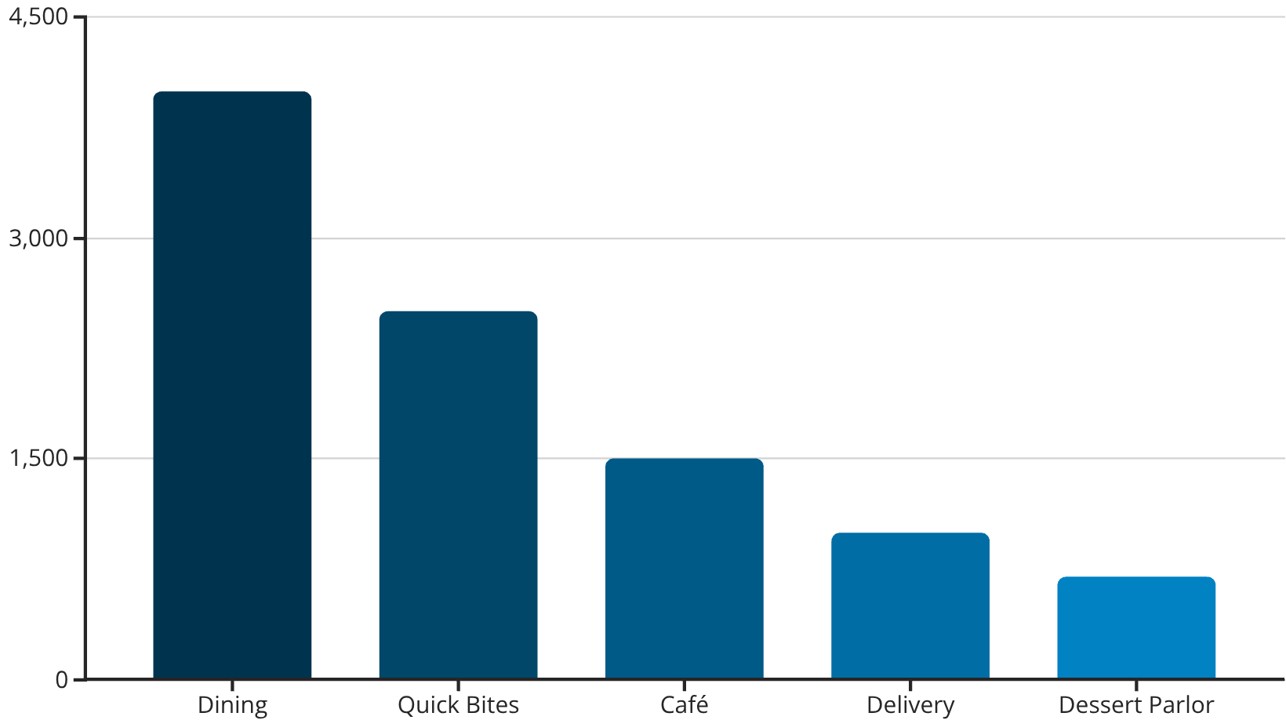
Customer Ordering Preferences
Insights:
"Dining" restaurants dominate the listings, suggesting they are the most common and potentially most frequently ordered from.
This implies a strong customer preference for sit-down meals, evidenced by the sheer volume of "Dining" establishments.
Understanding this distribution guides strategic decisions on where to focus marketing efforts.
The bar chart illustrates the count of restaurants by category, highlighting "Dining" as the prevailing type among listings.

Slide 6
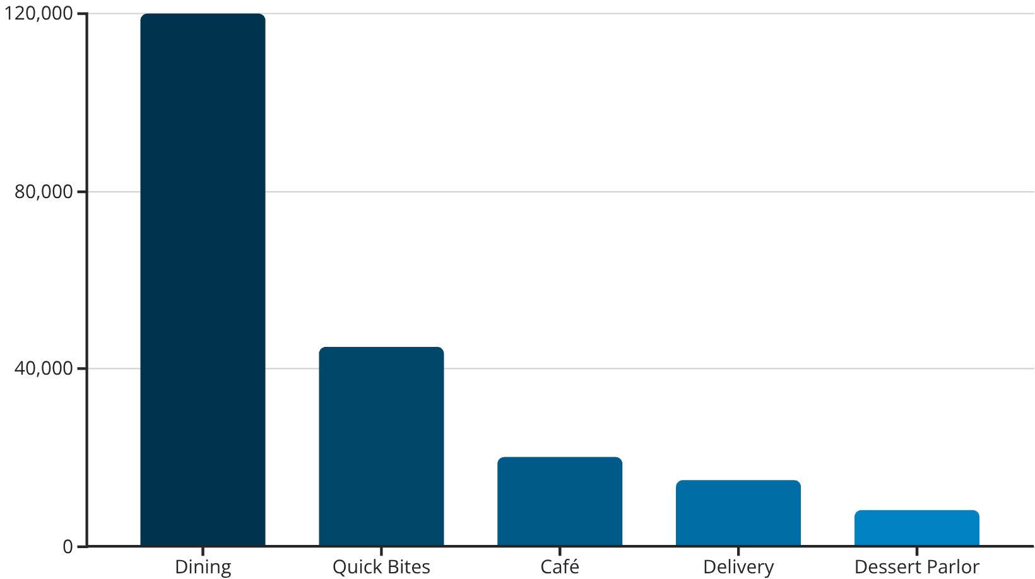
Customer Engagement: Votes by Restaurant Type
Key Takeaways:
"Dining" restaurants receive the most customer votes , indicating highest engagement.
This reinforces "Dining" as the most favored category, potentially due to its prevalence and customer preference for sit-down experiences.
Categories like "Quick Bites" and "Café" also show significant votes, but far less than "Dining."
This chart visually summarizes collective customer engagement per category, showing "Dining" restaurants accumulate the highest number of votes.

Slide 7
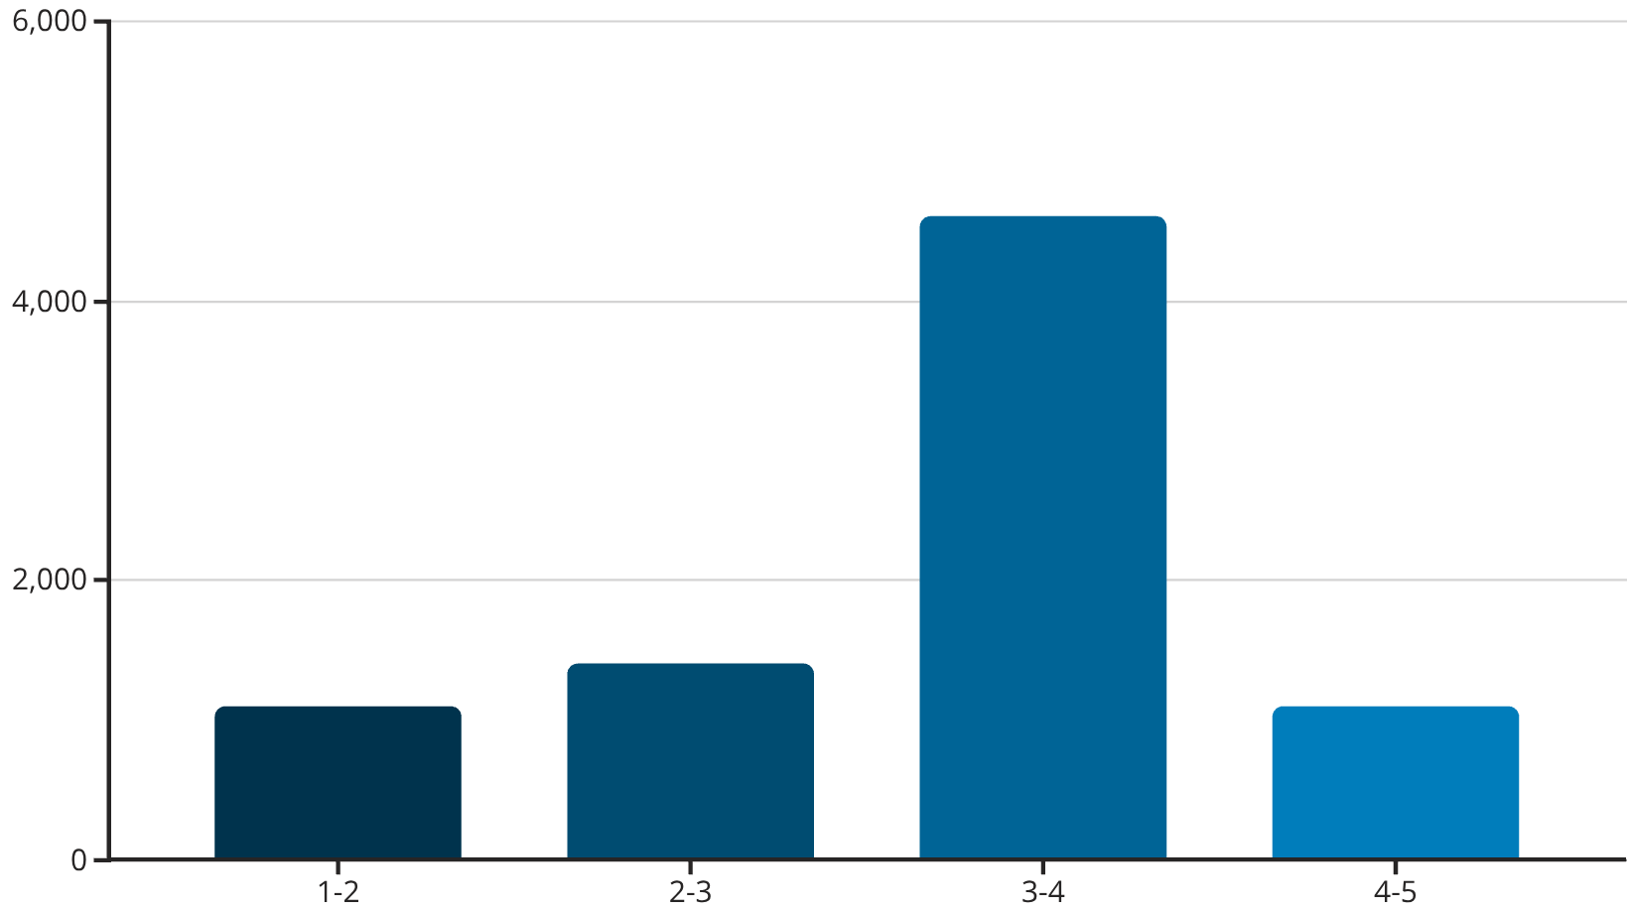
Customer Ratings: Understanding the Distribution
Key Findings:
Most restaurants fall within the 3-4 rating range , indicating generally satisfactory customer experiences.
High-rated (4-5) and low-rated (1-2) establishments are less common.
This distribution reflects a balance, with outstanding and poor experiences being rarer.
This chart illustrates the distribution of restaurant ratings, highlighting the most common rating ranges.

Slide 8
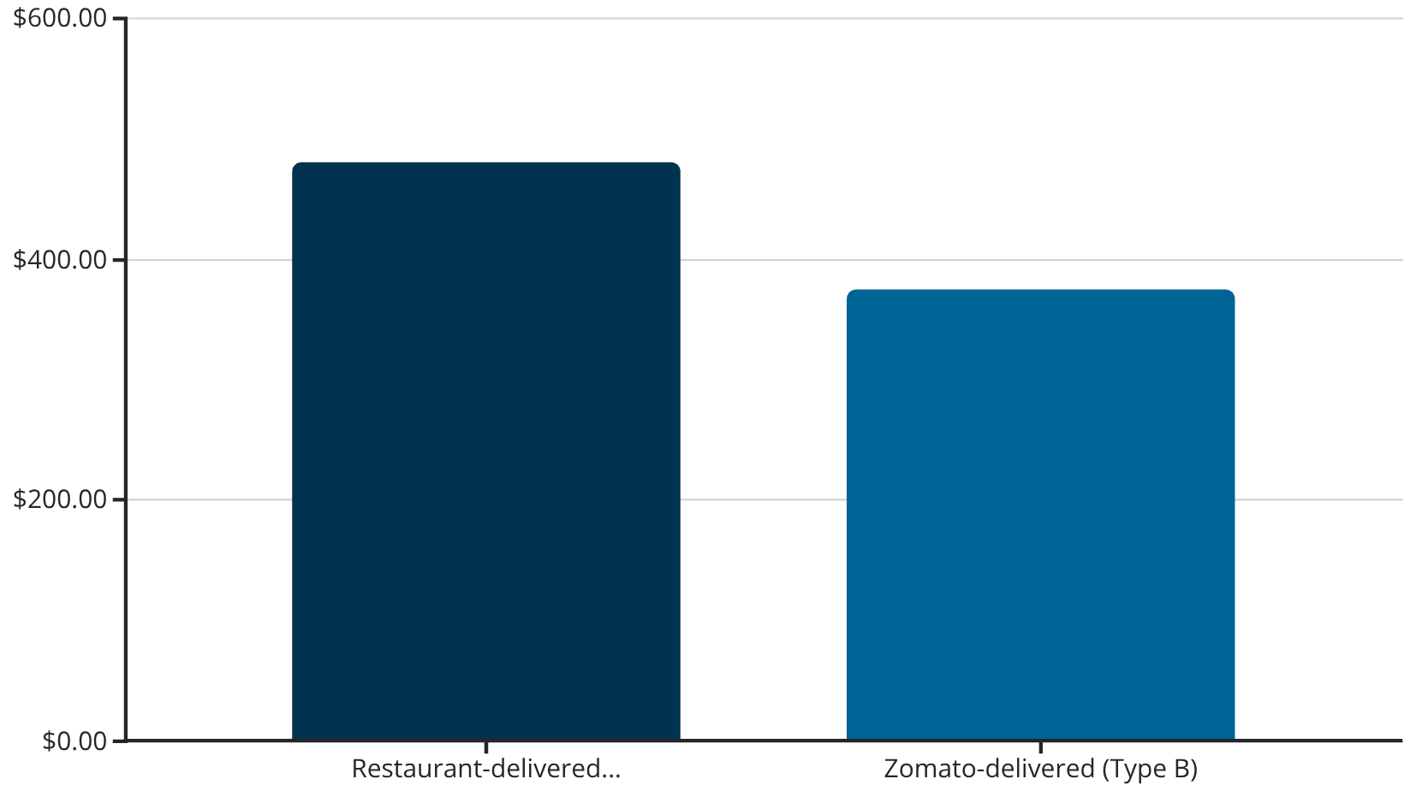
Average Order Value for Couples
Insights:
Couples predominantly order online, with an average spending range of ₹375 - ₹480 per order.
Restaurant-handled deliveries (Type A) show a higher average order value compared to Zomato-handled deliveries (Type B).
This data informs pricing strategies and promotional offers targeting couples.
This chart visualizes the average order values based on delivery type, providing an approximation for couple spending.

Slide 9
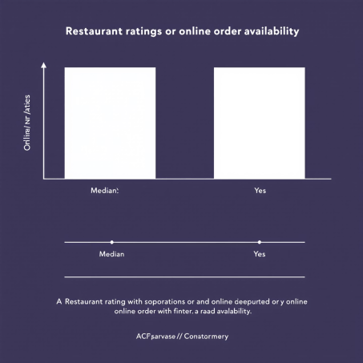
Rating Comparison: Online vs. Offline Ordering
Key Insight:
Restaurants that accept online orders generally receive higher average ratings.
Conversely, restaurants primarily operating offline tend to have slightly lower ratings.
This suggests that offering online ordering enhances customer satisfaction and perceived quality.
The box plot illustrates that restaurants with online ordering capabilities tend to receive higher customer ratings.

Slide 10
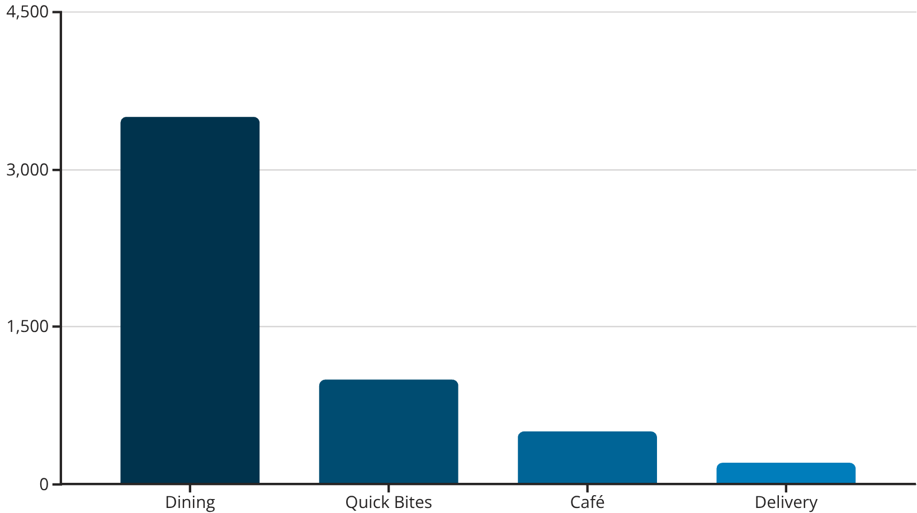
Targeting Offline Orders: Restaurant Types
Strategic Recommendation:
"Dining" restaurants receive the most offline orders , making them ideal targets for promotions.
Zomato should focus on developing compelling offers tailored for dine-in experiences at these establishments.
This approach maximizes the impact of offline marketing efforts.
This chart indicates which restaurant types receive the most offline orders, guiding targeted promotional strategies.

